Slide 1
Prioritizing Services and Tools to Support Data Management in Repositories
Open Repositories
9 July 2012
Ann Green, Digital Life Cycle Research & Consulting
Jared Lyle, ICPSR

Slide 2

Support:
Notes:
Funding for this survey was made possible by a 2009 IMLS National Leadership Grant.

Slide 3
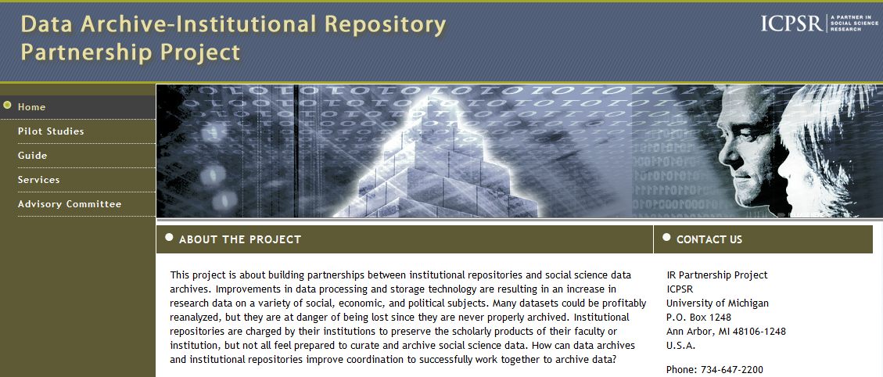
http://www.icpsr.umich.edu/icpsrweb/IR/

Slide 4
Partnerships
“We propose that domain specific archives partner with institution based repositories to provide expertise, tools, guidelines, and best practices to the research communities they serve.”
Green, Ann G., and Myron P. Gutmann. (2007) "Building Partnerships Among Social Science Researchers, Institution-based Repositories, and Domain Specific Data Archives." OCLC Systems and Services: International Digital Library Perspectives. 23: 35-53. http://hdl.handle.net/2027.42/41214

Slide 5
Data preservation, dissemination & long term stewardship:
Repositories and data archives provide preservation services such as format migration and media refreshment; dataset may survive a period of dis-interest before being re-discovered
Data creation, collection, repurposing: Partnerships between researchers & support services with subject expertise; informed by domain standards and guidelines relating to formats, metadata, version control, etc.
Discovery and Planning
Repositories
Long term access
Data Analysis
PARTNERSHIPS
Curation services
Data processing, management and curation:
Data are transformed, cleaned, derived as part of the research process; curators identify ‘partnering moments' to capture content for documentation and description. Staging repositories offer curatorial workspaces
Data sharing and distribution:
Repositories ingest and manage research outputs; offer federated searching, redundant storage, access controls; scholarly publications linked to data
Researchers
Publication and Sharing
Ann Green, DISK-UK DataShare 2007
Notes:
Title: Partnerships in the data and research life cycle
Research life cycle: blue arrows
Data life cycle: yellow boxes

Slide 6
Hand offs to connect the dots
Chris Rusbridge: “digital preservation is like a relay race, with different parties taking responsibility for a limited period and then 'passing the baton'.”

Slide 7
Rethinking Roles and Responsibilities
What would it take to build this partnership between IRs, social science support services, and domain repositories?
Where is it already happening?
What are the incentives, costs, challenges?

Slide 8
Survey distributed March & April 2012 to:
Research Data Management discussion list (RESEARCH-DATAMAN@jiscmail.ac.uk)
Digital Curation Google Group (digital-curation@googlegroups.com)
Institutional Repository Managers’ Mailing List (REPOMAN-L@listserv.indiana.edu)
SPARC Institutional Repositories discussion list (SPARC-IR@arl.org)
SPARC-SR discussion list (sparc-sr@arl.org)
JISC-REPOSITORIES mailing list (JISC-REPOSITORIES@jiscmail.ac.uk)
DuraSpace repository community
Fedora repository community
Digital Commons repository community
IASSIST listserv
ICPSR announcements Web page
ICPSR OR announcements list

Slide 9
Overall - Demographics
60% completion rate (109/181)
27 U.S. states + D.C.
6 Canadian provinces
UK, AU, NL, NO, SA
66% respondents from social science repository mailing list

Slide 10
Overall – Type of Organization (n=96)
Answer | Response | %
College or University | 81 | 84%
Private organization | 2 | 2%
Government organization | 5 | 5%
Other | 8 | 8%
Notes:
Other:
non-profit organization funded mostly by provincial govt organization (workers' compensation board)
academic law library
University department
ngo
Repository Service Provider
network funded by NSF
General research support

Slide 11
Overall – Role within Organization (n=95)
Answer | Response | %
Librarian | 54 | 57%
Repository Manager | 35 | 37%
Software Developer | 7 | 7%
Manager | 15 | 16%
Library Director / Senior Manager | 10 | 11%
Faculty Member | 11 | 12%
Researcher | 14 | 15%
Other | 10 | 11%
Notes:
Other:
Statistical Support
manager of collections, including digital imagery and data
data archivist
Research Coordinator charged w/ task of developing data management processes
digital archivist
Data librarian
Provide Technical and Advisory Support to Repository Providers
Archivist
Government Documents Librarian
special events designer/presenter

Slide 12
Overall – Types of Data Received
Of those who’d received or were planning to receive data (80%):
Social Sciences (69%)
Physical Sciences (47%)
Humanities (36%)
Biomedical (36%)
Engineering (24%)
Notes:
For 80% section, n=96.

Slide 13
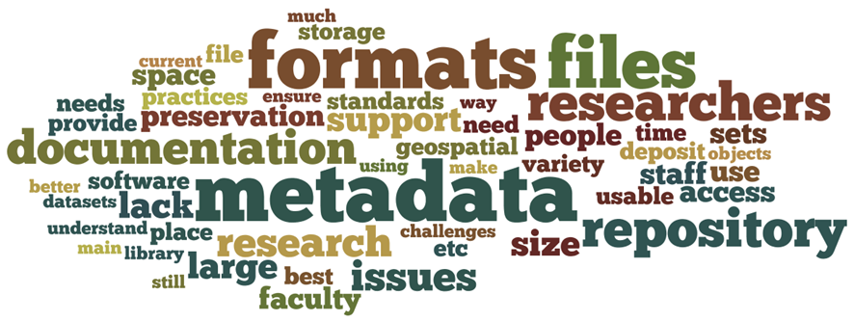
Challenges (everyone)
Notes:
The top 50 words (excluding ‘data’) from the free text responses to the question, “As you see it, what are the main challenges your repository faces when working with data?”

Slide 14
Challenges
Formats, data recovery, media recovery
Size: “The materials are often held in very large files, or consist of complex objects. Our current repository doesn't support either well.” / “Bandwidth.”
Range of formats
Preservation: “Being able to pull out the data and have it still be viable.”

Slide 15
Challenges
Metadata, documentation, catalog linkages
Curation: “Making it meaningful and useful outside of the application that created it.”
Discoverability: “How to expose data to wider world (except by title or descriptors).”
Exploration: “Making data available for online analysis.”

Slide 16
Challenges
Costs, policies
Politics: “Lack of clarity about institutional support in terms of long-term financial sustainability and firm commitment.”
Standards: “Uncertainty about how to deal with a multitude of data formats, file types, software, etc ; lacking best practices to follow.”

Slide 17
Challenges
Confidential data, confidentiality review
Review and Treatment: “We have no capability to do disclosure reviews, so it is possible that people are giving us data that could identify individuals.”

Slide 18
Challenges
Support networks, training
Faculty cooperation: “The main challenges are much more sociopolitical than technological - convincing faculty & research staff that the library is the place to store and preserve their data.”

Slide 19
Services
“If others were to offer the following services to help repositories work with data, which would be useful?”

Slide 20
If others were to offer the following services to help repositories work with data, which would be useful?
Format migration – “I need help moving SPSS data into SAS.”
Metadata tools – “I need help describing a data collection; the current metadata fields in my repository don’t fit.”
Data recovery – “I need help opening data stored as SPSS version 3.”
Costs – “I need help estimating costs to curate and disseminate a data collection.”

Slide 21
If others were to offer the following services to help repositories work with data, which would be useful?
Policy review – “I need help creating and/or reviewing policies related to appraisal and preservation.”
Confidential data dissemination – “I need help sharing confidential data with others in a secure way.”
Documentation – “I need help describing variables in my data collection.”
Media recovery – “I need help retrieving data from a 9-track tape.”

Slide 22
If others were to offer the following services to help repositories work with data, which would be useful?
Confidentiality review – “I need help treating data containing sensitive personal information.”
Support networks – “I want to connect with others who are working through similar data issues.”
Linking to a union catalog – “I would like to get our metadata about data collections known to the researchers/community.”
Training about quantitative data – “I want to learn more about how to work with statistical packages and quantitative data.”

Slide 23
If others were to offer the following services to help repositories work with data, which would be useful?
Answer | All Completed Surveys: Useful Services – Mean Rank (# mentions) | Repository Managers: Useful Services – Mean Rank (# mentions)
Format migration | 2.81 (41) | 3.40 (15)
Metadata tools | 3.03 (48) | 4.06 (17)
Data recovery | 3.22 (36) | 3.77 (13)
Costs | 3.40 (41) | 3.26 (19)
Policy review | 3.96 (38) | 3.94 (16)
Confidential data dissemination | 4.04 (36) | 5.91 (11)
Documentation | 4.08 (40) | 4.05 (19)
Media recovery | 4.26 (32) | 3.15 (13)
Confidentiality review | 4.32 (37) | 5.57 (14)
Support networks | 4.45 (53) | 4.32 (19)
Linking to a union catalog | 4.47 (30) | 4.45 (11)
Training about quantitative data | 5.30 (29) | 5.91 (11)
Notes:
Note higher ranking of Media Recovery and lower ranking of Metadata Tools and Confidentiality issues by Repository Managers.

Slide 24
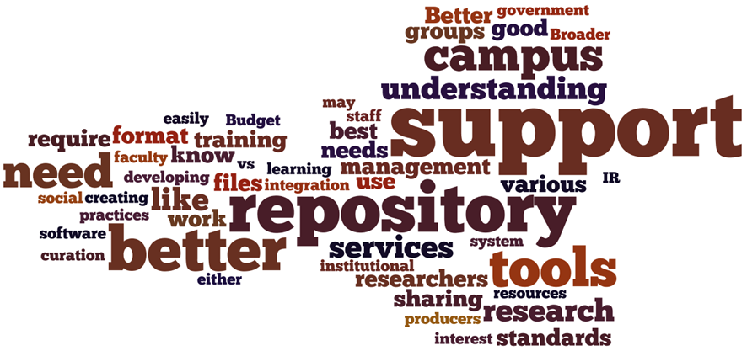
Solutions (everyone)
Notes:
The top 50 words (excluding ‘data’) from the free text responses to the question, “What do you need to overcome these challenges of working with data?”

Slide 25
Solutions
Formats, data recovery, media recovery
Tools: “Flexible tools that can be easily and seamlessly adapted to the various needs of our unit and can, ideally, be integrated into researchers' workflow.”
Specialized Repositories: “We would like to establish a separate repository infrastructure tailored for holding various types of data - linking through to the institution repository.”

Slide 26
Solutions
Metadata, documentation, catalog linkages
Completeness: Make it easy to add and use domain-specific metadata.
Platforms: Work with vendors to improve repository platforms and software (e.g., metadata) to align with data community’s needs.
Citation Standards: Encourage use of data citation standards in IRs.

Slide 27
Solutions
Costs, policies
More Resources: “Better funding to enable us to employ more and more skilled staff, to improve our infrastructure and expand our services.”
Sample Policies: Collected and shared across institutions.
Infrastructure: Consult on strategies to use shared storage and replication.

Slide 28
Solutions
Confidential data, confidentiality review
Tools: E.g., ‘Anonymizer’
Standards: “Clear and widely-accepted disclosure standards for data.”
Training & Consulting: Managing restricted use data.

Slide 29
Solutions
Support networks, training
Researcher Training: “A summary of best practices for researchers to apply when curating their own data in anticipation of depositing it.”
Staff Training: “To begin with we just need some firsthand experience in order to answer questions we have.”
Case Studies: Share case studies of working with data.
Practical Examples: Show practical examples of presenting data in an IR.
Consulting: Consult directly with IRs (e.g., disclosure reviews, data management plans)

Slide 30
Your Ideas???
Useful categories for discussion?
Media recovery, format migration, data recovery
Cost estimating and policy review
Metadata tools, documentation, and catalog linkages
Support networks and training
Confidential data dissemination and confidentiality review

Slide 31
green.ann@gmail.com
lyle@umich.edu

